Slide 1
mathematical optimization
CO2- Integer programming – Branch & Bound
Session 8

Slide 2





AIM OF THE SESSION
To familiarize students with the basic concept of Integer linear Programming.
INSTRUCTIONAL OBJECTIVES
This Session is designed to:
Introduce the need for integer linear Programming in real life
Introduce types of integer linear Programming
Teach the steps of solving an integer programming problem using the concepts such as branching, lower and upper bounds and fathoming, Introduce the concept of degree of difficulty
Illustrate the method using a solved example..
LEARNING OUTCOMES
At the end of this session, the students should be able to:
Understand the difference between linear programming and integer linear programming
Be able to solve an integer programming problem by using Linear Programming Relaxation as an initial step.

Slide 3
INTEGER PROGRAMMING: AN INTRODUCTION
An Integer Programming (IP) model is one where one or more of the decision variables has to take on an integer value in the final solution
Solving an IP problem is much more difficult than solving a Linear Programming (LP) problem
If requiring integer values is the only way in which a problem deviates from a linear programming formulation, then it is an Integer Programming (IP) problem. The more complete name is Integer Linear Programming, but the adjective linear normally is dropped except when this problem is contrasted with the more esoteric integer nonlinear programming problem
So, The mathematical model for integer programming is the linear programming model with the one additional restriction that the variables must have integer values

Slide 4
TYPES OF INTEGER PROGRAMMING PROBLEMS
PURE-INTEGER PROBLEMS
  require that all decision variables have integer solutions.
MIXED-INTEGER PROBLEMS
  Require some, but not all, of the decision variables to have integer values in the final solution, whereas others need not have integer values.
0–1 INTEGER PROBLEMS
  Require the variables to have value of 0 or 1, such as situations in which decision variables are of the yes- no type.

Slide 5
INTEGER PROGRAMMING:
FORMULATION
Pure IL Problem:
A jewelery shop in the city specializes in ornaments and the manger has planned to limit the use of diamonds to the artistic configuration of diamond rings, diamond earnings and diamond necklaces. The three items require the following specifications:
ORNAMENT DIAMOND
 | ½ Carat | ¼ Carat
Ring | 4 | 6
Earring (Pair) | 3 | 5
Necklace | 10 | 9
Availability | 150 | 160
The jeweler does not want to configure the diamond into more than 50 items. The per unit profit for the rings is Rs. 1500, for earnings is Rs. 2400 and for necklace is Rs. 3600. Formulate the problem as an ILP model for maximizing the profit.

Slide 6
INTEGER PROGRAMMING:
FORMULATION
Decision Variables: Let X₁,X₂, X₃, denote the number of diamond rings, number of pair of earrings, and number of necklaces respectively.
Objective Function: Max. Z = 1500X₁ + 2400X₂ + 3600X₃
Subject to: 4X₁ + 3X₂ + 10X₃ ≤ 150 (1/2 Carat Diamond)
6X₁ + 5X₂ + 9X₃ ≤ 160 (1/4 Carat Diamond)
X₁ + X₂ + X₃ ≤ 50 (Total Number of items)
With X₁, X₂, X₃ ≥ 0; X₁, X₂, X₃ are integers

Slide 7
INTEGER PROGRAMMING:
FORMULATION
Pure IL Problem:
Northeastern Airlines is considering the purchase of new long-, medium-, and short- range jet passenger airplanes. The purchase price would be $67 million for each long- range plane, $50 million for each medium-range plane, and $35 million for each short-
range plane. The board of directors has authorized a maximum commitment of $1.5 billion for these purchases. Regardless of which airplanes are purchased, air travel of all distances is expected to be sufficiently large that these planes would be utilized at essentially maximum capacity. It is estimated that the net annual profit (after capital recovery costs are subtracted) would be $4.2 million per long-range plane, $3 million
per medium-range plane, and $2.3 million per short-range plane.
It is predicted that enough trained pilots will be available to the company to crew 30 new airplanes. If only short-range planes were purchased, the maintenance facilities would be able to handle 40 new planes. However, each medium-range plane is equivalent to 4/3 short-range planes, and each long-range plane is equivalent to 5/3 short-range planes in terms of their use of the maintenance facilities.
The information given here was obtained by a preliminary analysis of the problem. A more detailed analysis will be conducted subsequently. However, using the preceding data as a first approximation, management wishes to know how many planes of each type should be purchased to maximize profit. Formulate an IP model for this problem.

Slide 8
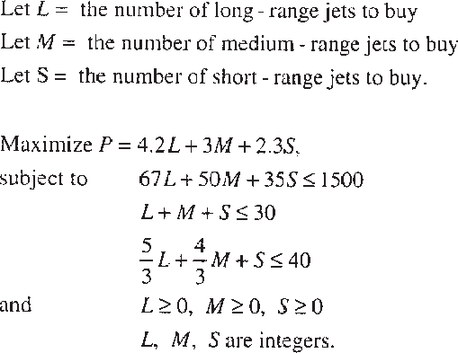
INTEGER PROGRAMMING:
FORMULATION

Slide 9
INTEGER PROGRAMMING:
FORMULATION
Mixed ILP
A textile company can use any or all of three different processes for weaving in standard white polyester fabric. Each of these production processes has a weaving machine setup cost and per square-meter processing cost. These costs and the capacities of each of the three production processes are shown below:
Process Number | Weaving machine Setup cost (Rs.) | Processing Cost (Rs.) | Maximum daily capacity (Sq. meter)
1 | 150 | 15 | 2000
2 | 240 | 10 | 3000
3 | 300 | 8 | 3500
Process Number | Weaving machine Setup cost (Rs.) | Processing Cost (Rs.) | Maximum daily capacity (Sq. meter)
1 | 150 | 15 | 2000
2 | 240 | 10 | 3000
3 | 300 | 8 | 3500
Process Number | Weaving machine Setup cost (Rs.) | Processing Cost (Rs.) | Maximum daily capacity (Sq. meter)
1 | 150 | 15 | 2000
2 | 240 | 10 | 3000
3 | 300 | 8 | 3500
The daily demand forecasts for its white polyester fabric is 4000 Sq. meter. The company’s production manager wants to determine the optimal combination of the production processes and their actual daily production levels such that the total production cost is minimized.

Slide 10
INTEGER PROGRAMMING:
FORMULATION
Process Number | Weaving machine Setup cost (Rs.) | Processing Cost (Rs.) | Maximum daily capacity (Sq. meter)
1 | 150 | 15 | 2000
2 | 240 | 10 | 3000
3 | 300 | 8 | 3500
Decision Variables: Let X_{j} be the production level for process j (j = 1, 2, 3) also let
  Y_{j} = 1 if process j is used, and
  Y_{j} = 0 if process j is not used
Objective Function:
  Minimize Z = (15X₁ + 10X₂ + 8X₃) + (150Y₁ + 240Y₂ + 300Y₃ )
Subject to:
X₁ + X₂ + X₃ = 4000 (Daily Diamond)
X₁ – 2000Y₁ ≤ 0 (Daily Capacity of Process-1)
X₂ – 3000Y₂ ≤ 0 (Daily Capacity of Process-2)
X₃ – 3500Y₃ ≤ 0 (Daily Capacity of Process-3)
With X₁, X₂, X₃ ≥ 0; Y_{j} = 0 or 1, j= 1, 2, 3

Slide 11
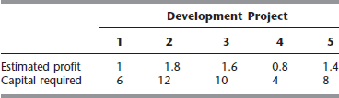
INTEGER PROGRAMMING:
FORMULATION
Zero–One ILP
A real estate development firm, Peterson and Johnson, is considering five possible development projects. The following table shows the estimated long-run profit (net present value) that each project would generate, as well as the amount of investment required to undertake the project, in units of millions of dollars.
The owners of the firm, Dave Peterson and Ron Johnson, have raised $20 million of investment capital for these projects. Dave and Ron now want to select the combination of projects that will maximize their total estimated long-run profit (net present value) without investing more than $20 million. Formulate a Binary Integer Programming (0–1) model for this problem.

Slide 12
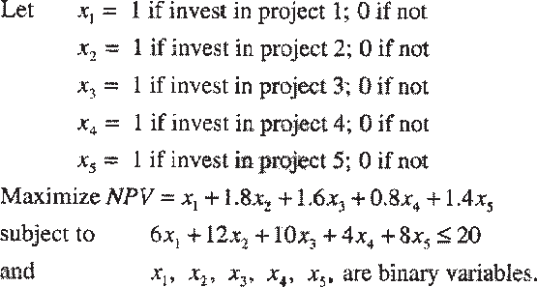
INTEGER PROGRAMMING:
FORMULATION

Slide 13
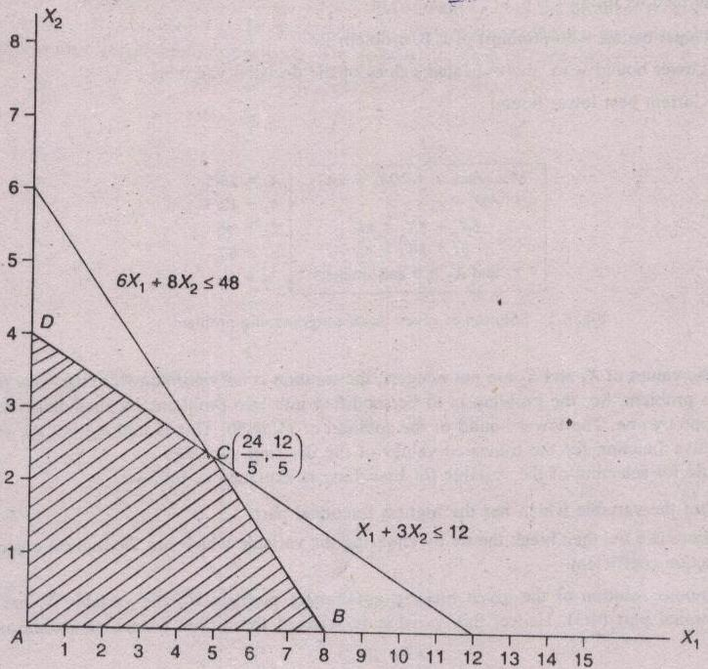
APPROACH TO SOLVING ILP PROBLEM
Firstly, we solve the LPP problem without integer constraints on the decision variables. Then, we search for solutions with integer values for the decision variables. Finally, decide the optimal solution with integer value constraints.
Z (A) = 10 (0) + 20 (0) = 0
Z(B) = 10 (8) + + 20 (0) = 80
Z(C) = 10 (24/5) + + 20 (12/5) = 96
Z(D) = 10 (0) + + 20 (4) = 80
Max. Z = 10X1 + 20X2
Subject to:
6X1 + 8X2 ≤ 48
X1 + 3X2 ≤ 12
X1, X2 ≥ 0 and integers
Optimal solution to relaxed LPP:
Z = 96
X1 =24/5
X2 = 12/5

Slide 14
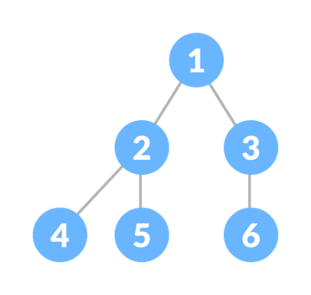
METHODS FOR SOLVING ILP PROBLEMS
Branch–and–Bound Method
  (Developed By: A.H. Land and A. G. Doing)
Cutting–Plane Method
  (developed by: Ralph E. Gomory)
Source: https://www.programiz.com/dsa/complete-binary-tree

Slide 15
BRANCH–AND–BOUND METHOD
BRANCHING:
  Selection of an integer value of a decision variable to examine for a possible integer solution to a problem
  If the solution to the linear programming problem contains non-integer values for some or all decision variables, then the solution space is reduced by introducing constraints with respect to any one of those decision variables. If the value of the decision variable “X1” is 24/5, then two more problems will be created by using each of the following constraints.
    X1 ≤ 4 X1 ≥ 5.
Max. Z = 10X1 + 20X2
Subject to:
6X1 + 8X2 ≤ 48
X1 + 3X2 ≤ 12
X1, X2 ≥ 0 and integers
Optimal solution to relaxed LPP:
Z = 96
X1 =24/5
X2 = 12/5

Slide 16
BRANCH–AND–BOUND METHOD
BOUND:
  An upper or lower limit on the value of the objective function at a given stage of the analysis of an ILP.
  UPPER BOUND: The upper bound at a node is the value of the objective function corresponding to the linear programming solution in that node: Z_{U} = Z(C) = 10 (24/5) + + 20 (12/5) = 96
  LOWER BOUND: The lower bound at a node is the value of the objective function corresponding to the truncated values (integer parts) of the decision variables of the problem in that node. Z_{L} = 10x4 + 20x2 = 80
Max. Z = 10X1 + 20X2
Subject to:
6X1 + 8X2 ≤ 48
X1 + 3X2 ≤ 12
X1, X2 ≥ 0 and integers
Z (A) = 10 (0) + 20 (0) = 0
Z(B) = 10 (8) + + 20 (0) = 80
Z(C) = 10 (24/5) + + 20 (12/5) = 96
Z(D) = 10 (0) + + 20 (4) = 80

Slide 17
BRANCH–AND–BOUND METHOD (Cont…)
Source: https://www.programiz.com/dsa/complete-binary-tree
FATHOMED SUBPROBLEM / NODE: A problem is said to be fathomed if any one of the following three conditions is true:
  The values of the decision variables of the problem are integer.
  The upper bound of the problem which has non–integer values for its decision variables is not greater than the current best lower bound.
  The problem has infeasible solution.
This means that further branching from this type of fathomed nodes is not necessary.
CURRENT BEST LOWER BOUND: This is the best lower bound (highest in the case of maximization problem and lowest in the case of minimization problem) among the lower bounds of all the fathomed nodes. Initially, it (Z_{B}) is assumed as -infinity for the root node.

Slide 18
BRANCH–AND–BOUND METHOD (Cont…)
Solve the given linear programming problem graphically or using iterative method. Set, the current best lower bound Z_{B} as -∞.
Check, Whether the problem has integer solution. If yes, print the current solution as the optimal solution and stop; Otherwise go to Step 3.
Identify the variable Xk which has the maximum fractional part as the branching variable. (In case of tie, select the variable which has the highest objective function coefficient.)
Create two more problems by including each of the following constraints to the current problem and solve them.
  Xk ≤ Integer part of Xk
  Xk ≥ Next Integer of Xk
If any one of the new sub-problems has infeasible solution or fully integer values for the decision variables, the corresponding node is fathomed. If a new node has integer values for the decision variables, update the current best lower bound as the lower bound of that node if its lower bound is greater than the previous current best lower bound.
Are all terminal nodes fathomed? If answer is yes, go to step 7; otherwise,
identify the node with the highest lower bound and go to step 3.
Select the solution of the problem with respect to the fathomed node whose lower bound is equal to the current best lower bound as the optimal integer solution.

Slide 19
BRANCH–AND–BOUND METHOD: A Solved problem
Max. Z = 10X1 + 20X2
Subject to:
6X1 + 8X2 ≤ 48
X1 + 3X2 ≤ 12
X1, X2 ≥ 0 and integers
Z (A) = 10 (0) + 20 (0) = 0
Z(B) = 10 (8) + + 20 (0) = 80
Z(C) = 10 (24/5) + + 20 (12/5) = 96
Z(D) = 10 (0) + + 20 (4) = 80
Optimal LPP solution:
Z = 96
X1 =24/5
X2 = 12/5
This is NOT an integer solution.
Let us follow the branch and bound method.

Slide 20
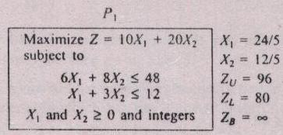
BRANCH–AND–BOUND METHOD: A Solved problem
Z (A) = 10 (0) + 20 (0) = 0
Z(B) = 10 (8) + + 20 (0) = 80
Z(C) = 10 (24/5) + + 20 (12/5) = 96
Z(D) = 10 (0) + + 20 (4) = 80
In Problem (P₁), X₁ has the highest fractional part 4/5.
Hence, “X₁” is selected for further branching.
Z_{U} = Upper bound = Z (Optimum) of relaxed LP Problem.
  Z_{U} = 10(24/5) + 20(12/5) = 96
Z_{L} = Lower bound w. r. t. the truncated values of the decision variables
  Z_{L} = 10(4) + 20(2) = 80
Z_{B} = Current Best Lower Bound
  = -infinity

Slide 21
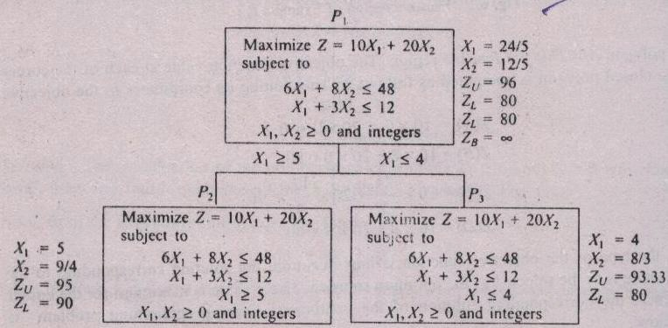
BRANCH–AND–BOUND METHOD (Cont…)

Slide 22
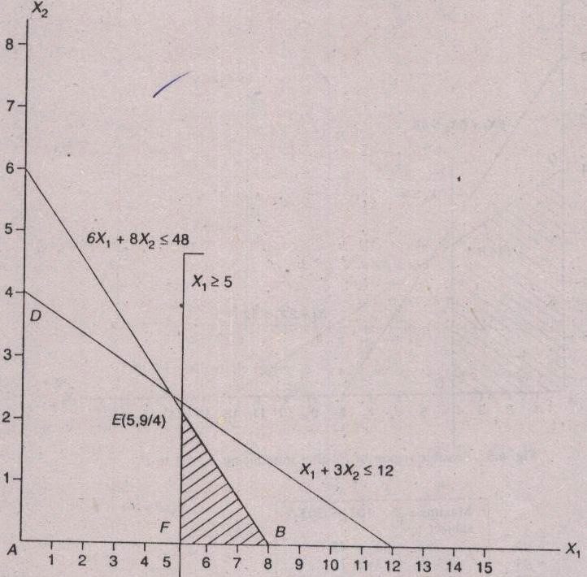
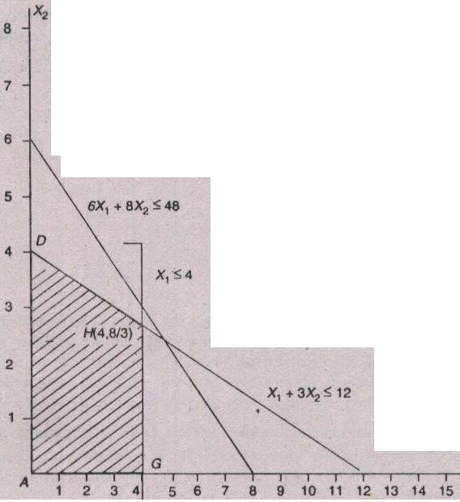
BRANCH–AND–BOUND METHOD (Cont…)
Feasible Region of P₃ after
introduction X1 ≤ 4 to P₁
Feasible Region of P₂ after
introduction X1 ≥ 5 to P₁

Slide 23
BRANCH–AND–BOUND METHOD (Cont…)
Problem P₂ has the highest lower bound (Z_{L} ) of 90 among the unfathomed terminal nodes. So, the further branching is done from P2 node.
Z_{U} = 95 Z_{B}=90

Slide 24
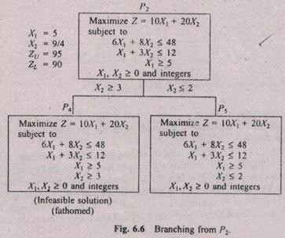
BRANCH–AND–BOUND METHOD (Cont…)

Slide 25
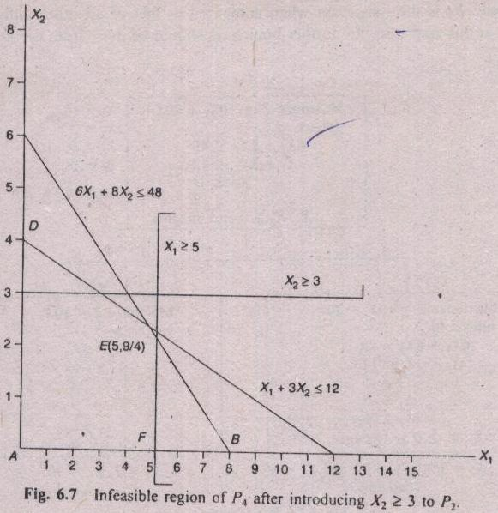
BRANCH–AND–BOUND METHOD (Cont…)

Slide 26
BRANCH–AND–BOUND METHOD (Cont…)
X₁ = 16/3
X₂ = 2
Z_{U} = 93.33
Z_{L} = 90

Slide 27
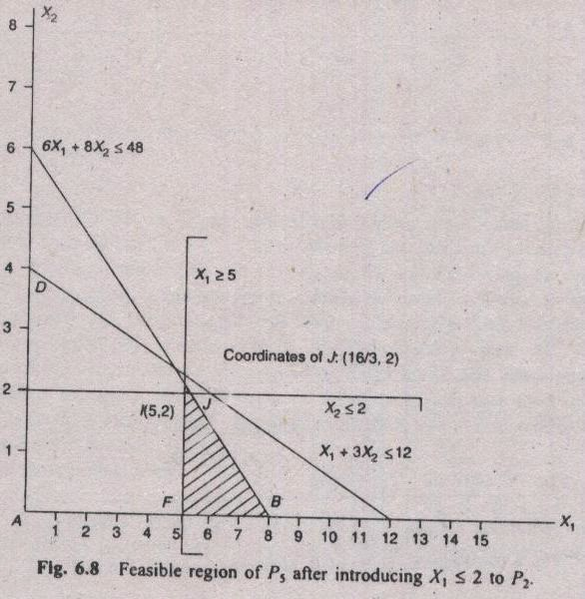
BRANCH–AND–BOUND METHOD (Cont…)

Slide 28
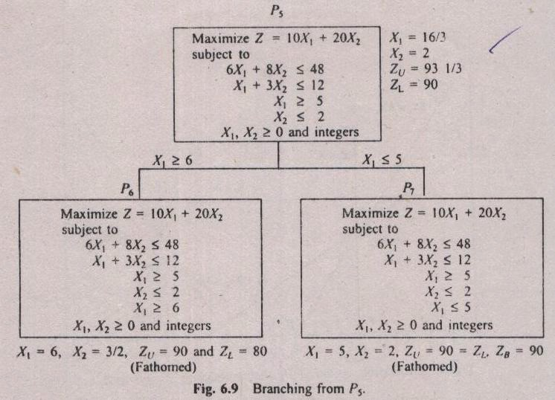
BRANCH–AND–BOUND METHOD (Cont…)

Slide 29
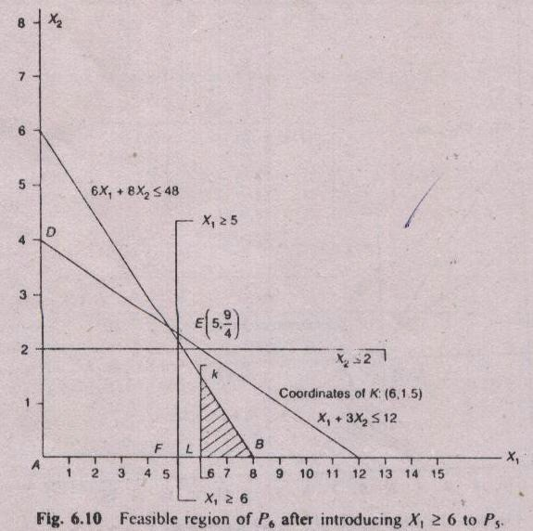
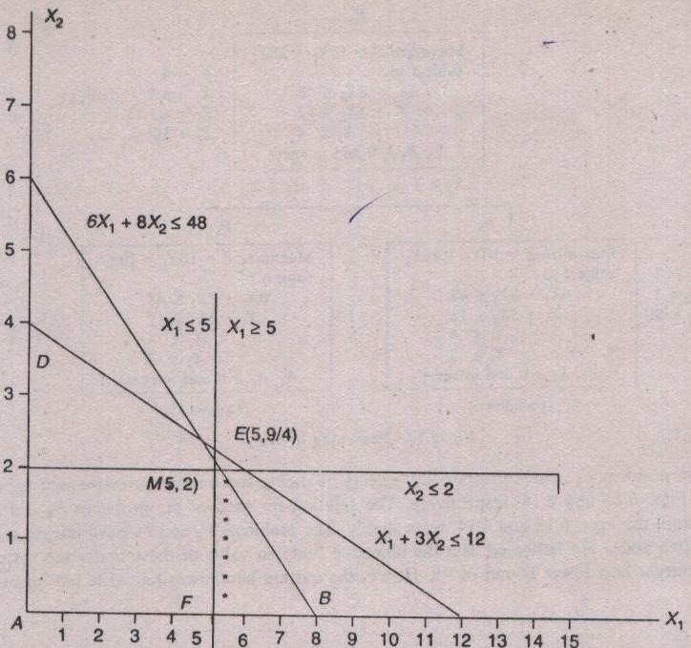
BRANCH–AND–BOUND METHOD (Cont…)
The solution of P₆ is non–integer and its Z_{L} = 80 and Z_{U} = 90. Since, Z_{U} ≤ (Current best Z_{L} =90), the node P6 is also fathomed and it has infeasible solution in terms of not fulfilling integer constraints for the decision variables.
The Problem P₇ has integer solution. So, it is a fathomed node. Hence the current best lower bound (Z_{B}) is updated to the objective function value 90.

Slide 30
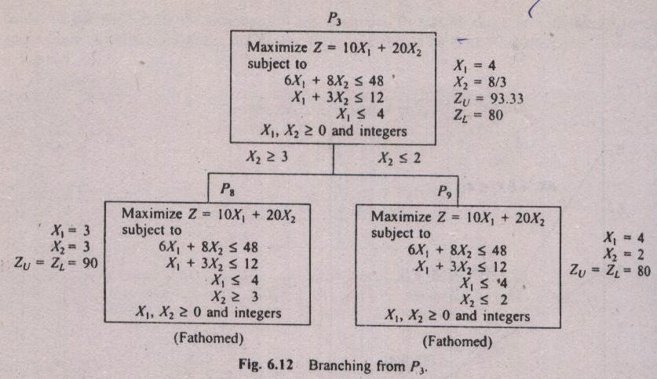
BRANCH–AND–BOUND METHOD (Cont…)
Now, the Only unfathomed terminal node is P₃. The further branching from this node is shown below:

Slide 31
BRANCH–AND–BOUND METHOD (Cont…)
The problems P₈ and P₉ have integer solution. So, these two nodes are fathomed.
But the objective function value of these nodes are not greater than the current best lower bound of 90. Hence, the current best lower bound is not updated.
Now, all the terminal nodes are fathomed. The feasible fathomed node with the current best lower bound is P₇.
Hence, its solution is treated as the optimal solution: X₁=5, X₂ =2, Z(Optimum) = 90
NOTE: This Problem has alternative optimum solution at P₈ with X₁=3, X₂=3, Z(Optimum)=90

Slide 32
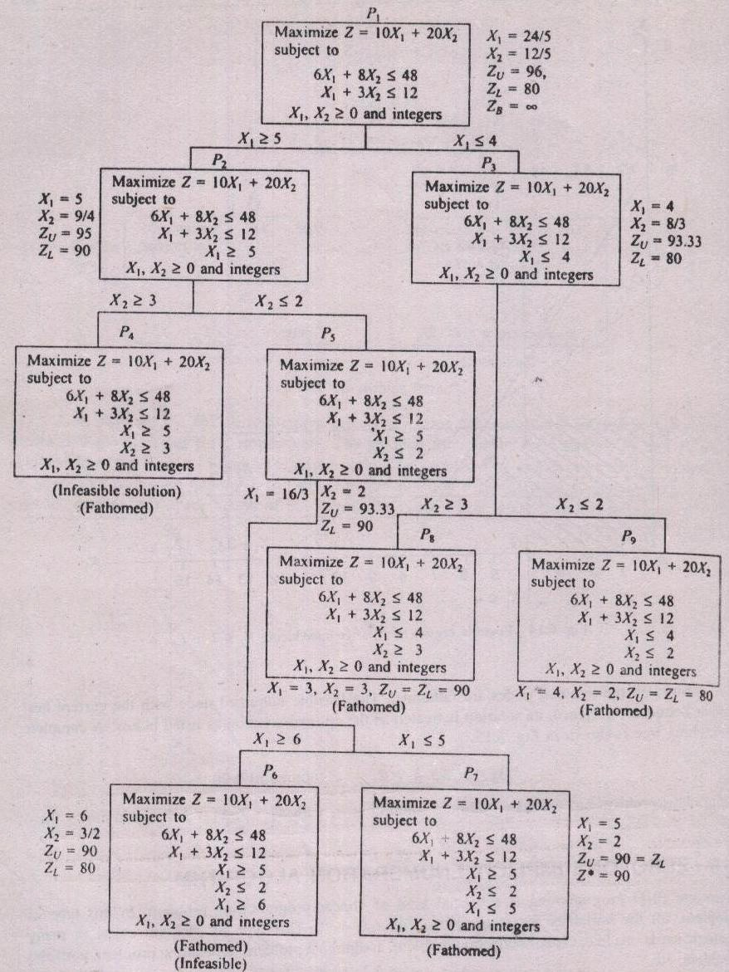
BRANCH–AND–BOUND METHOD (Cont…)
Complete Tree:

Slide 33
BRANCH–AND–BOUND METHOD (Cont…)
Solve the given linear programming problem graphically or using iterative method. Set, the current best lower bound Z_{B} as -∞.
Check, Whether the problem has integer solution. If yes, print the current solution as the optimal solution and stop; Otherwise go to Step 3.
Identify the variable Xk which has the maximum fractional part as the branching variable. (In case of tie, select the variable which has the highest objective function coefficient.)
Create two more problems by including each of the following constraints to the current problem and solve them.
  Xk ≤ Integer part of Xk
  Xk ≥ Next Integer of Xk
If any one of the new sub-problems has infeasible solution or fully integer values for the decision variables, the corresponding node is fathomed. If a new node has integer values for the decision variables, update the current best lower bound as the lower bound of that node if its lower bound is greater than the previous current best lower bound.
Are all terminal nodes fathomed? If answer is yes, go to step 7; otherwise,
identify the node with the highest lower bound and go to step 3.
Select the solution of the problem with respect to the fathomed node whose lower bound is equal to the current best lower bound as the optimal integer solution.

Slide 34
TERMINAL QUESTIONS
1.What are the 3 conditions under with a node is fathomed.
2. How do you select the branching variable?
3. If a branching variable has value 22/7, what will be the additional constraints of the two sub problems?
4. Consider the following linear programming model
  maximize Z = 5x₁ + 4x₂
  subject to
    3x₁ + 4x₂ <= 10
    x1, x2 >= 0 and integers
  Solve this model using the branch and bound method.
  Demonstrate the solution partitioning graphically.
Notes:
34

Slide 35
SELF-ASSESSMENT QUESTIONS
Pure ILP can have
A)All the decision variables has to have integer solutions
B) At least one decision variables has to have integer solutions
C) Both
D) none of the above
Types of ILP are
Pure
Mixed
0-1
All
Notes:
Answer 1 b and 2 c
35

Slide 36
REFERENCES FOR FURTHER LEARNING OF THE SESSION
Web links to NPTEL videos
”Integer Linear Programming Problem- Branch and Bound technique”, Dr. Isha Dhiman, https://www.youtube.com/watch?v=BzKUhT20wDc
“State space search: branch and bound”, Dr. Deepak Khemani, IIT Madras, NPTEL-NOC IITM, https://www.youtube.com/watch?v=ZF8xhXE0P20
Web Links to tutorials, blogs:
“Integer Programming: Branch and Bound method”, Miguel Casquilho, U. of Lisbon, https://web.tecnico.ulisboa.pt/mcasquilho/compute/_linpro/TaylorB_module_c.pdf
“Solving Integer Programming with Branch-and-Bound Technique”, Mustafa Çelebi Pınar , Bilkent University, Turkey, https://www.ie.bilkent.edu.tr/~mustafap/courses/bb.pdf
“A Tutorial on Integer Programming”, Matthew J. Saltzman, Clemson University, https://www.math.clemson.edu/~mjs/courses/mthsc.440/integer.pdf, Section 3.2
Books:
“Integer Linear Programming in Computational and Systems Biology: An entry-level text and course”, Dan Gusfield, URL: https://www.cambridge.org/core/books/integer-linear-programming-in-computational-and-systems-biology/A1E06EE0AC95E4D9911A49C7140CCF5B

